Slide 1
Modeling Political Campaigns as a Two-Mode Network with Heterogeneous Voting Strategies and Dynamic Vote-Seeking Candidates
Stephen Davies and Harmony Peura
University of Mary Washington, Computer Science
Fredericksburg, Virginia, USA

Slide 2
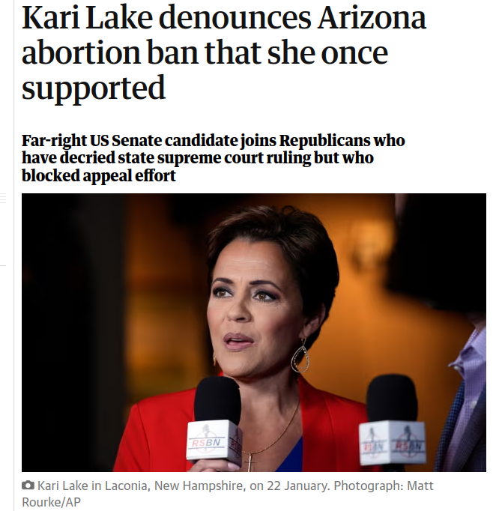

Slide 3
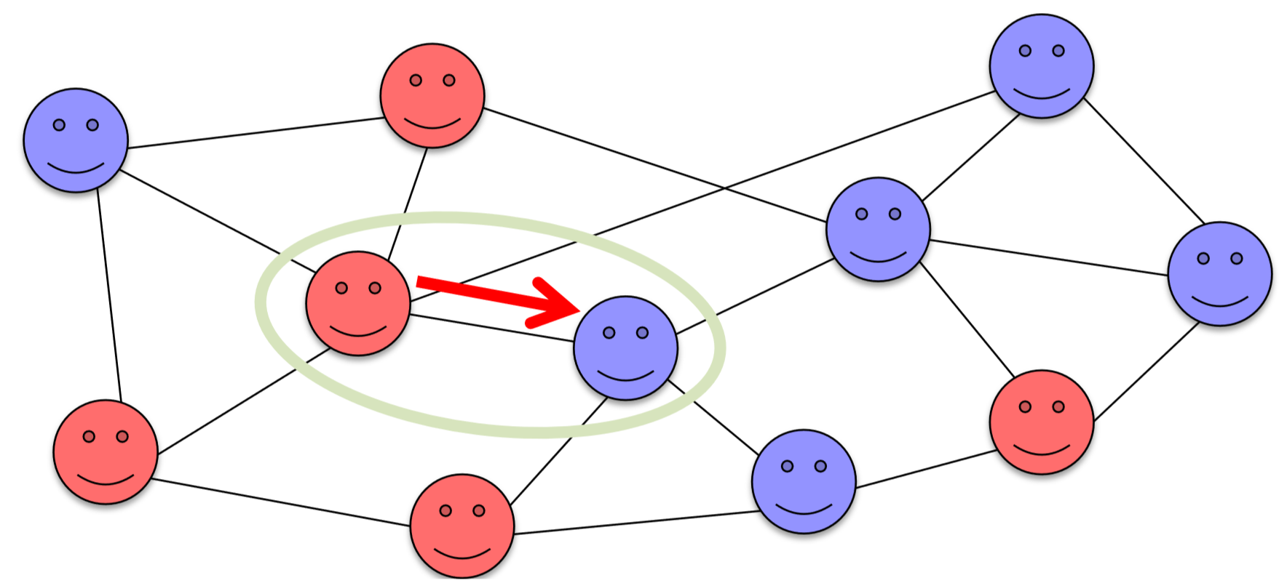
An Introduction to Opinion Dynamics: The Binary Voter Model
Each agent holds one binary opinion.
Agents interact with neighboring agents on a social network.
During an interaction, one agent adopts the other agent’s opinion.
Fun fact: the Binary Voter Model always leads to uniformity.
R. A. Holley and T. M. Liggett, “Ergodic theorems for weakly interacting infinite systems and the voter model,” The annals of probability, pp. 643–663, 1975.

Slide 4
An Overview of the Model
A two-node network: voter agents, and candidate agents.
An agent’s opinions on the various issues of the day are represented by a vector of reals on [0,1]. (This defines an opinion space.)
Neighboring voters influence one another. Candidates “chase” voters.
Each N steps, an election is held.
A voter is said to have voted “rationally” if they chose the candidate whose opinion vector is closest to their own (Euclidean distance).
An election outcome is said to be rational if the winning candidate is the candidate who would have won had all voters voted rationally.

Slide 5
Voter Agents: Cross-Issue Influence
1
2
3
Each agent has a vector of abstract opinions and a party affiliation.
X: [0.1, 0.8, 0.5]
When neighboring agents interact, they compare opinions on a random issue.
X: [0.1, 0.8, 0.5] Y: [0.7, 0.9, 0.3]
If they are roughly in agreement, Y will sway X’s opinion on a different issue.
X: [0.4, 0.8, 0.5]
J. Mittereder, R. S. W. Carroll, B. Frulla, and S. Davies, “Exploring the Impact of Social Network Density and Agent Openness on Societal Polarization,” in Proceedings of the 2021 Conference of The Computational Social Science Society of the Americas, Z. Yang and E. von Briesen, Eds., in Springer Proceedings in Complexity. Cham: Springer International Publishing, 2022, pp. 71–84.

Slide 6
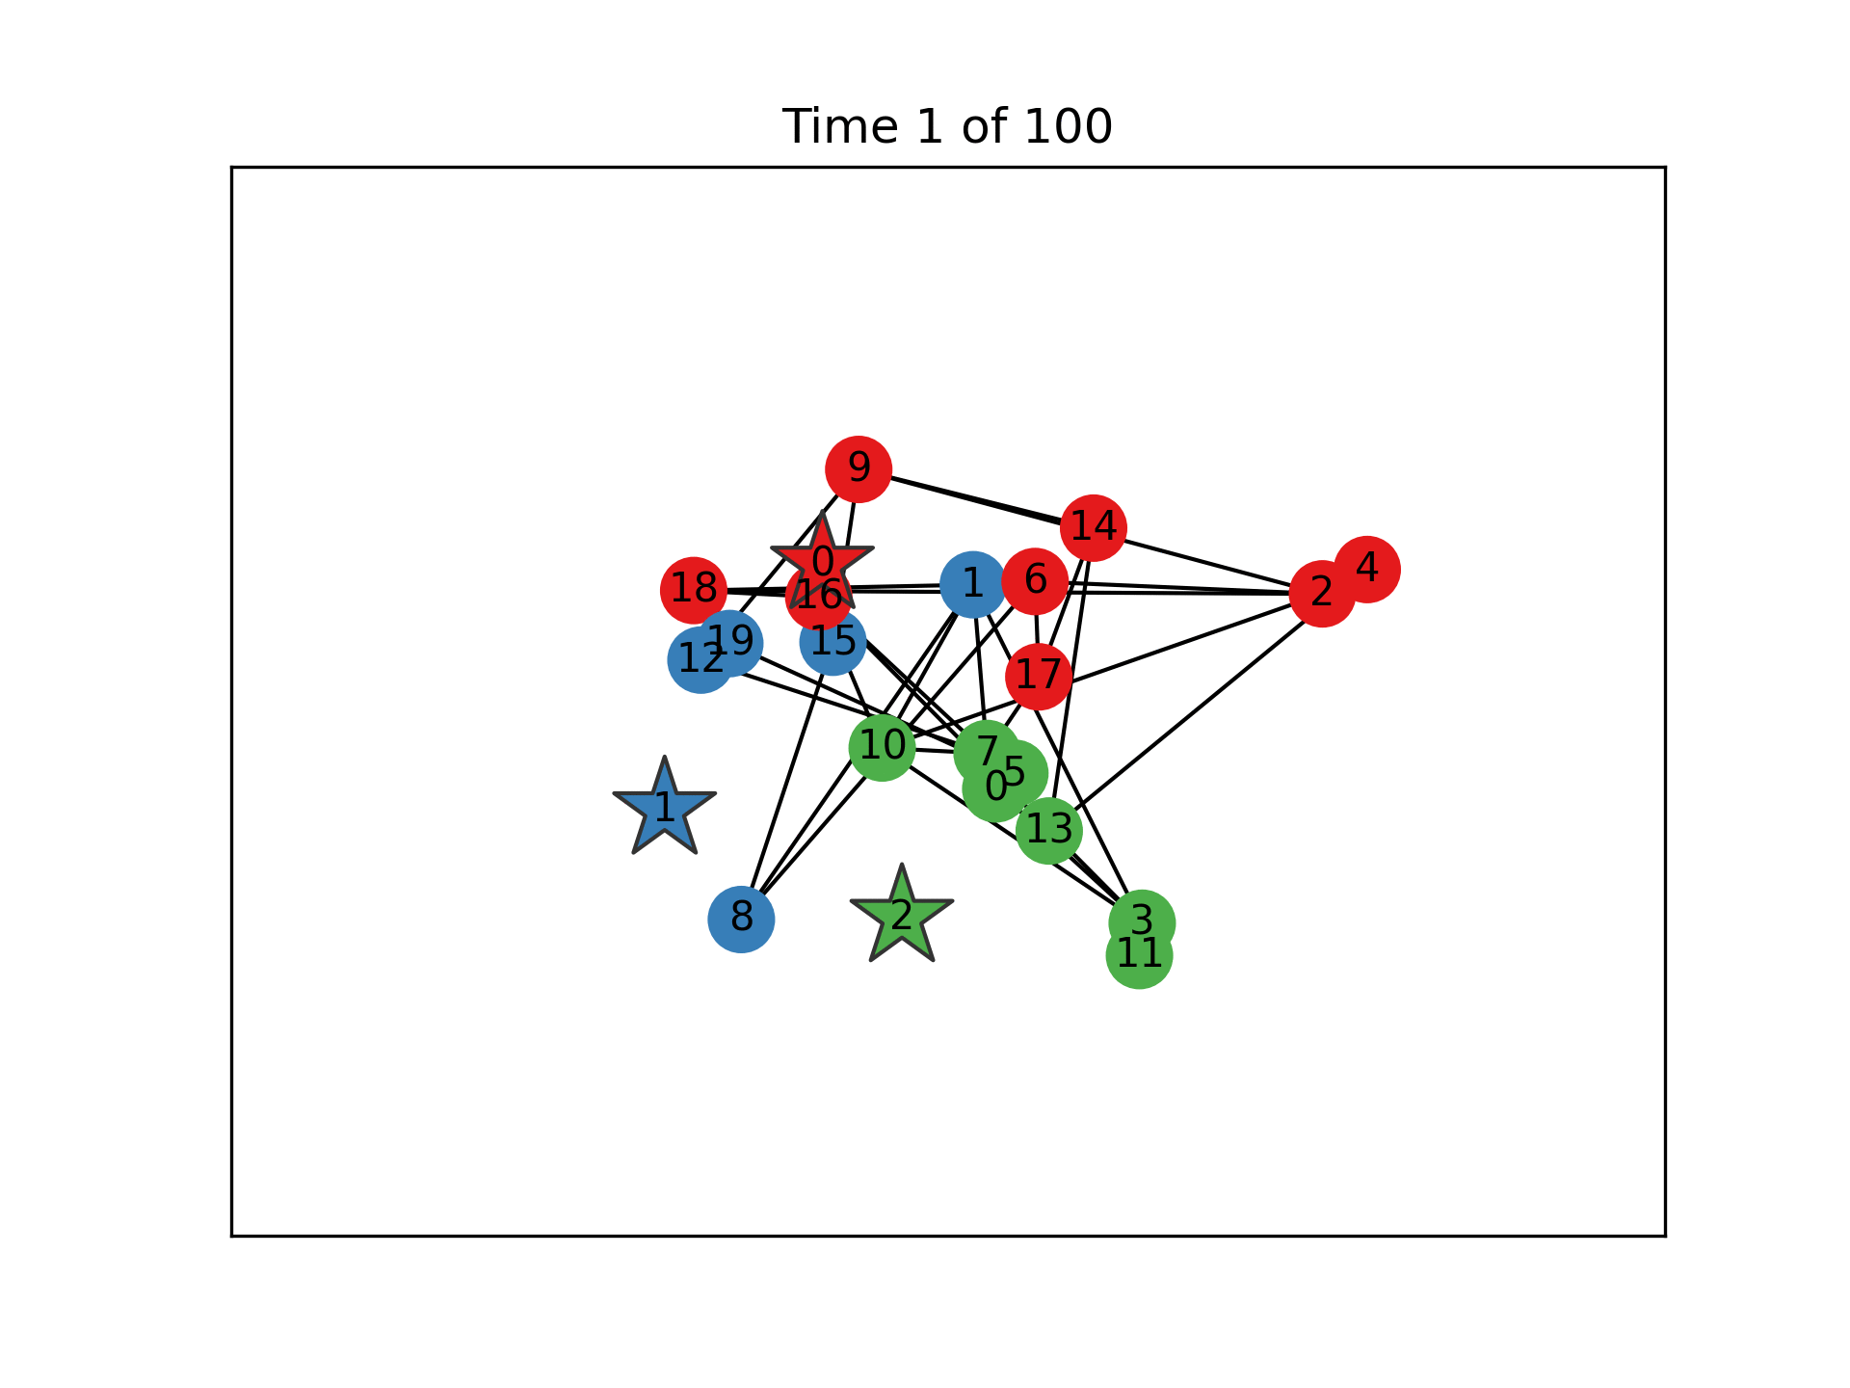
Dynamic visualization

Slide 7
Party Affiliations
All agents have a party affiliation.
Candidates are each given their own party. Voters’ initial party affiliations correspond to the candidate closest to them in opinion space.
Candidate agents never switch parties. Voters may switch parties if they move close enough to another party’s centroid.

Slide 8
Party Affiliations
Party centroid

Slide 9
Party Affiliations
Party centroid

Slide 10
Elections: How do Voters Make Decisions?
How do voters choose who to vote for?
Often, via a “satisficing” decision. They chose the candidate that is “good enough,” making trade-offs between a good decision and an easy decision.
Voters use a voting strategy to vote for a candidate.
We developed four algorithms to capture different kinds of satisficing observed in the political science literature.
Simon, H. A. (1956). Rational choice and the structure of the environment. Psychological Review, 63(2), 129-138

Slide 11
Voting Strategies
Rational - Choose candidate closest to voter’s opinion vector.
Party - Vote based purely on party affiliation.
Fast and Frugal (F&F) - Single-issue voters:
F&F 1 - Vote based on their own “core” issue.
F&F 2 - Vote based on the society’s current “hot topic” issue.
The voting algorithm distribution represents the proportion of the electorate deploying each of these four strategies.
D. P. Redlawsk, A Citizen’s Guide to the Political Psychology of Voting, 1st edition. New York: Routledge, 2020.

Slide 12
Experimentation and Results

Slide 13
Simulation Parameters and Variables
Parameters
Suite size of 1200
400 steps
50 steps between elections
20 voters
3 candidates
3 issues
Baseline voting algorithm distribution: ⅓ rational, ⅓ party, ⅓ F&F
Independent Variables
Chasers vs. non-chasers
Chase radius
Voting algorithm distributions
Dependent Variables
Election winners
Chase distance
Rationality

Slide 14
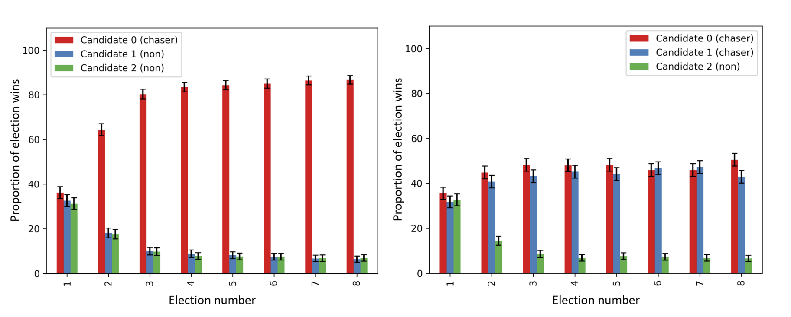
Chasing provides maximum benefit with a rational electorate
One Chaser
Two Chasers

Slide 15
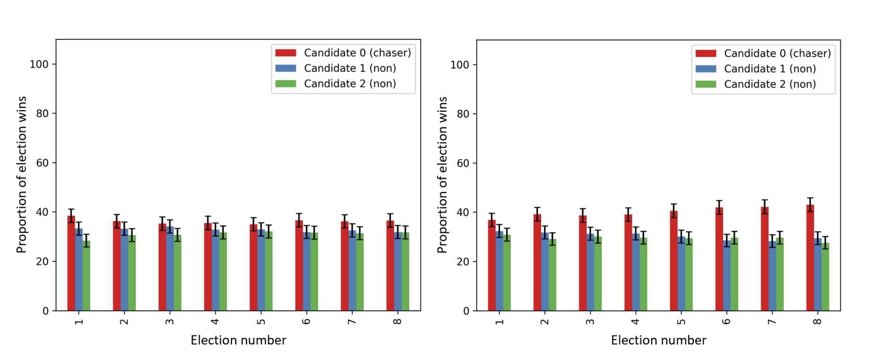
Chasing is not (as) advantageous with a Party-line or Fast & Frugal electorate
Party-line Electorate
Fast & Frugal Electorate

Slide 16
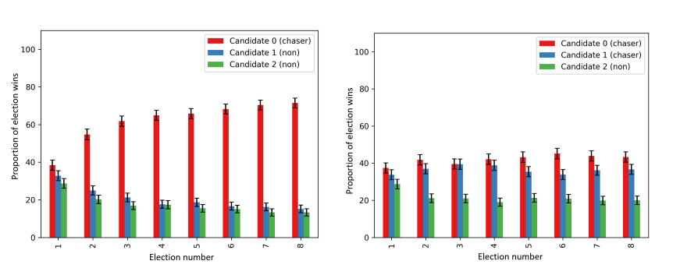
Multiple chasing candidates reduce one another’s gains with a varied electorate
One Chaser
Two Chasers

Slide 17
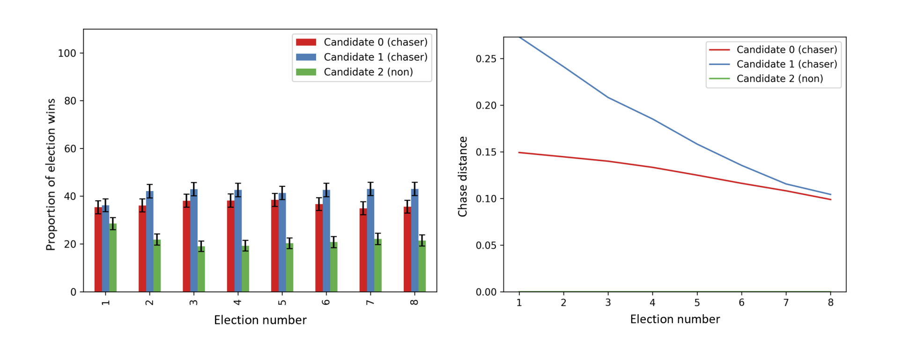
Aggressive Chasing Provides a Slight Advantage
Red: 0.1 chase radius
Blue: 0.2 chase radius
Red: 0.1 chase radius
Blue: 0.2 chase radius

Slide 18
Rationality Over Time with an Electorate of all Party-line Voters
No chasers
One chaser
Three chasers

Slide 19
Discussion
The efficacy of candidate chasing depend crucially on the makeup of the model’s electorate.
Chasing is extremely beneficial with a rational electorate.
Diminishing benefits when two candidates are chasing votes or the electorate is not rational.
In the model, party voting and single-issue voting reduce the rationality of elections.
When candidates chase an electorate that is not rational, they actually decrease the rationality of the outcomes over time.

Slide 20
Modeling Political Campaigns as a Two-Mode Network with Heterogeneous Voting Strategies and Dynamic Vote-Seeking Candidates
Stephen Davies and Harmony Peura
University of Mary Washington, Computer Science
Fredericksburg, Virginia, USA

